Slide 1

Portfolio Analysis

Slide 2

Power BI Insights

Slide 3
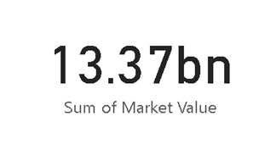
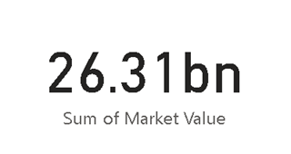
Portfolio Market Value
PORT_EUR PORT_ USD

Slide 4
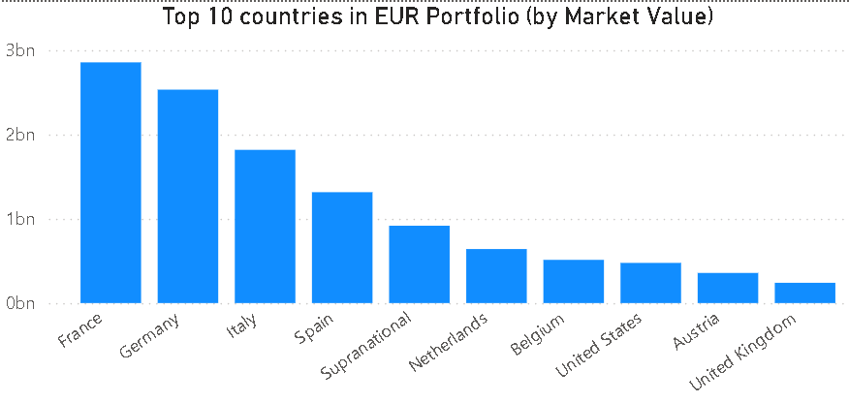
Country wise Distribution - EUR

Slide 5
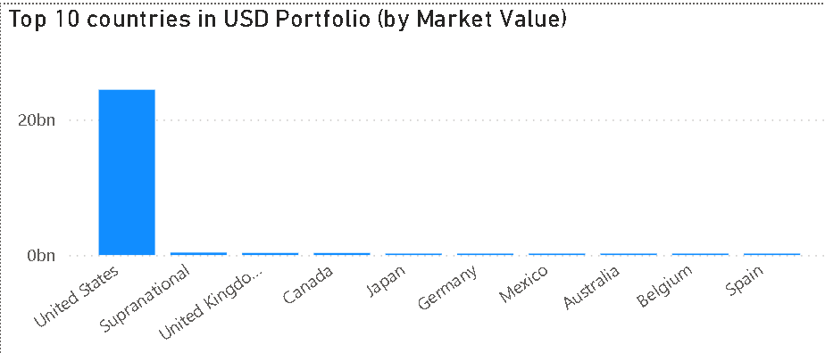
Country wise Distribution - USD

Slide 6
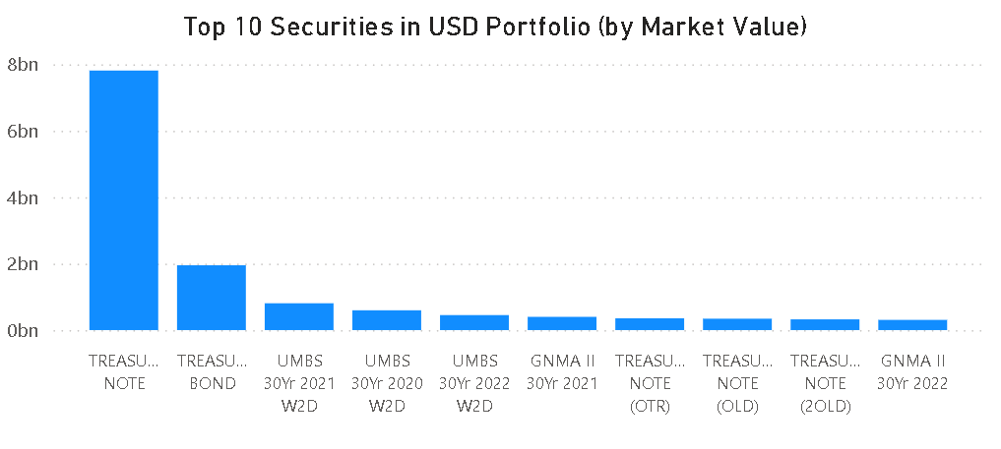
Top 10 Holdings –USD Portfolio

Slide 7
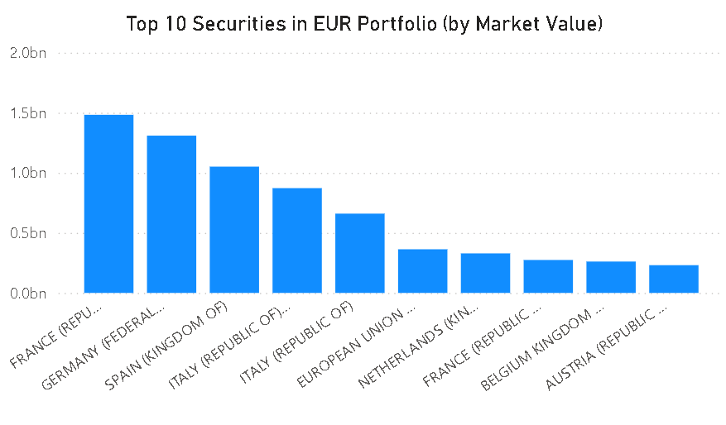
Top 10 Holdings –USD Portfolio

Slide 8
Key Insights
USD Portfolio is almost twice the size of EUR Portfolio with a Market Value of 26.31 Billion $
EUR Portfolio has diversified investments across major EU economies
USD Portfolio has majority of its investment in United States
The French government bonds are the most invested security in EUR Portfolio
The US Treasury notes are the most invested security in USD Portfolio

Slide 9
Sub Sector Distribution of Securities

Slide 10
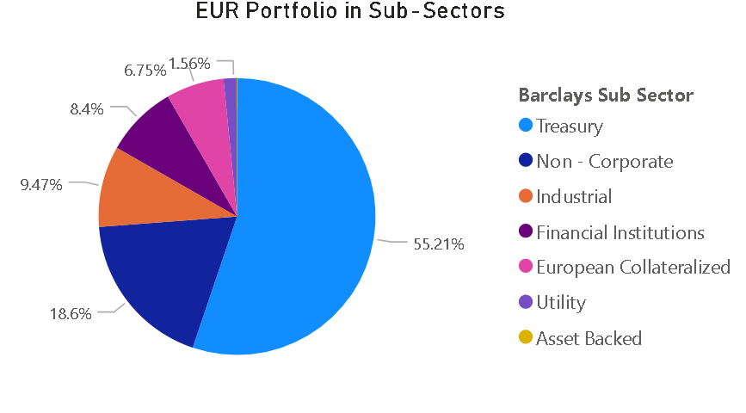
EUR Portfolio

Slide 11
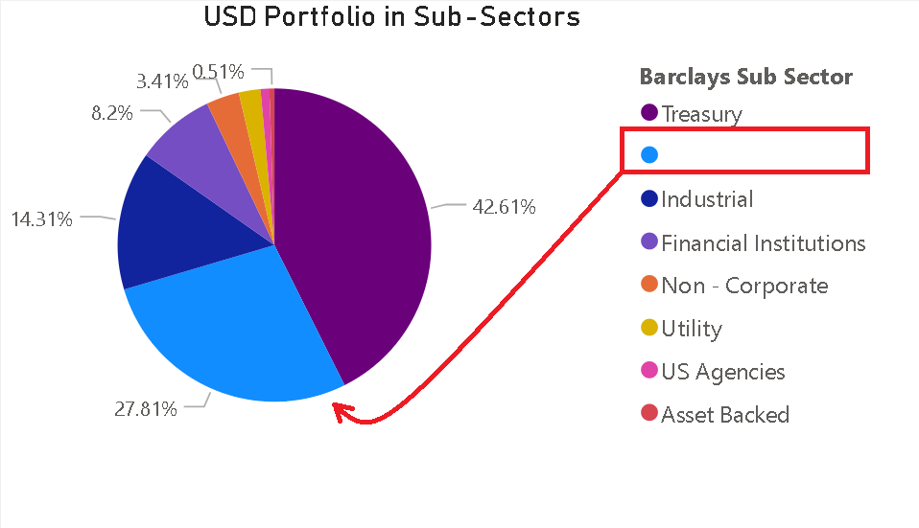
USD Portfolio

Slide 12
Key Insights
Majority of EUR securities are Treasury securities (Barclay’s Classification) followed by Non-Corporate securities
42.16% of USD securities are Treasury securities
Major component of USD portfolio (27.81 %) has ‘no sub sector classification’
These securities include:
- Municipal Bonds
- Government backed MBS
- Private MBS
- Gold Bonds

Slide 13
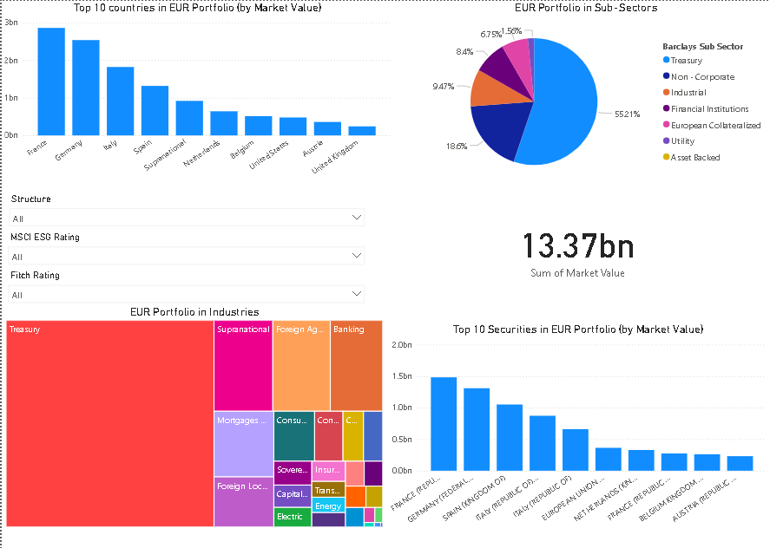
Interactive Power BI dashboard

Slide 14
Key Features
Interactable dashboard to visualize the data and draw insights
Pages dedicated to individual Portfolios
Visualizations for sub-sector, top holdings, countries, Industries
Data filterable on three levels
1.Structure
2.MSCI Rating
3.Fitch Rating

Slide 15
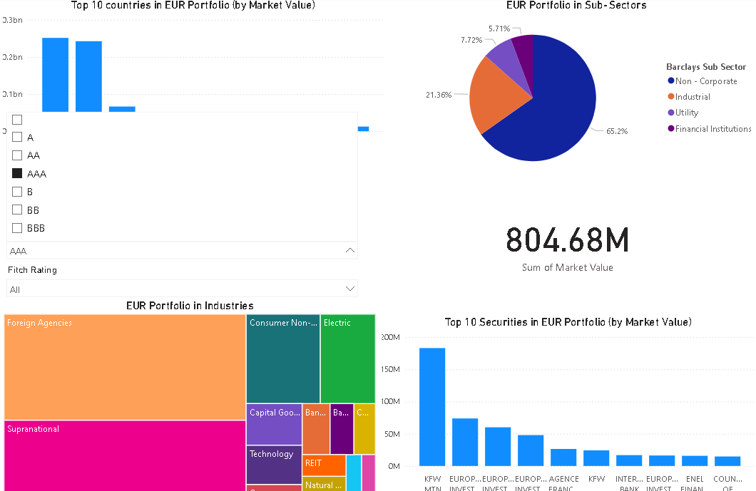
MSCI Rating- AAA

Slide 16
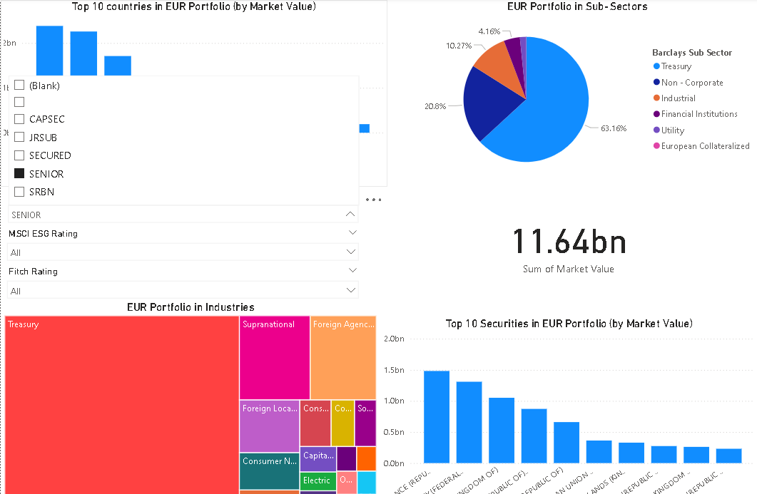
Structure filter – SENIOR tranche

Slide 17

Streamlit

Slide 18
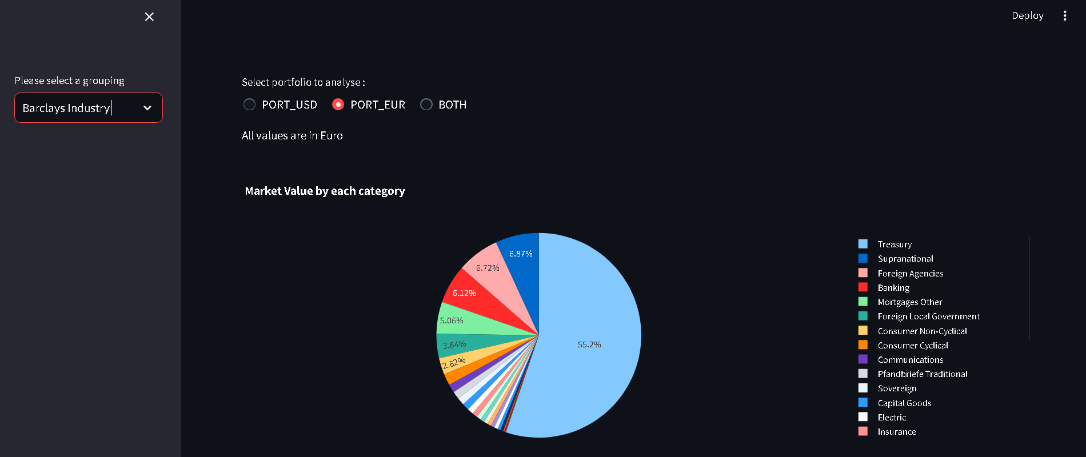
PORT_EUR

Slide 19
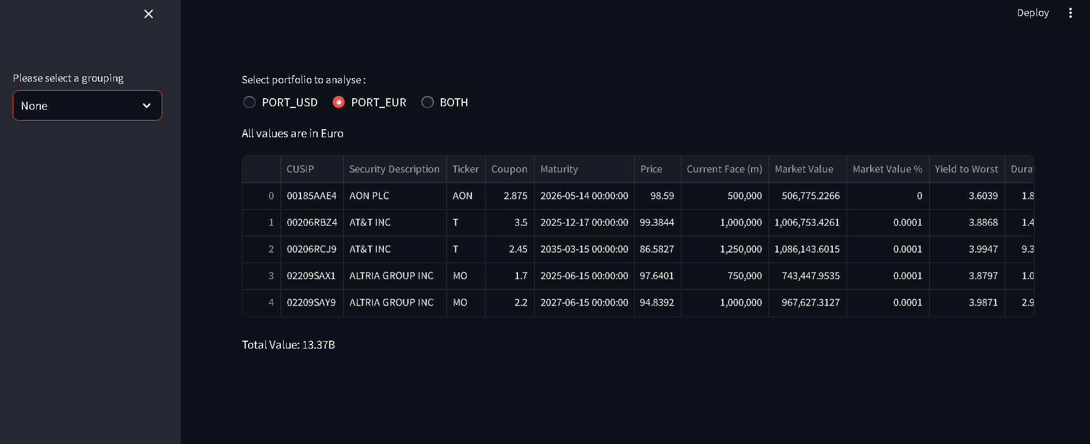

Slide 20
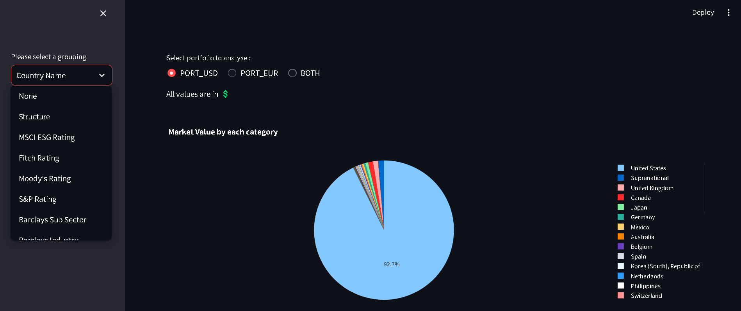
PORT_USD

Slide 21
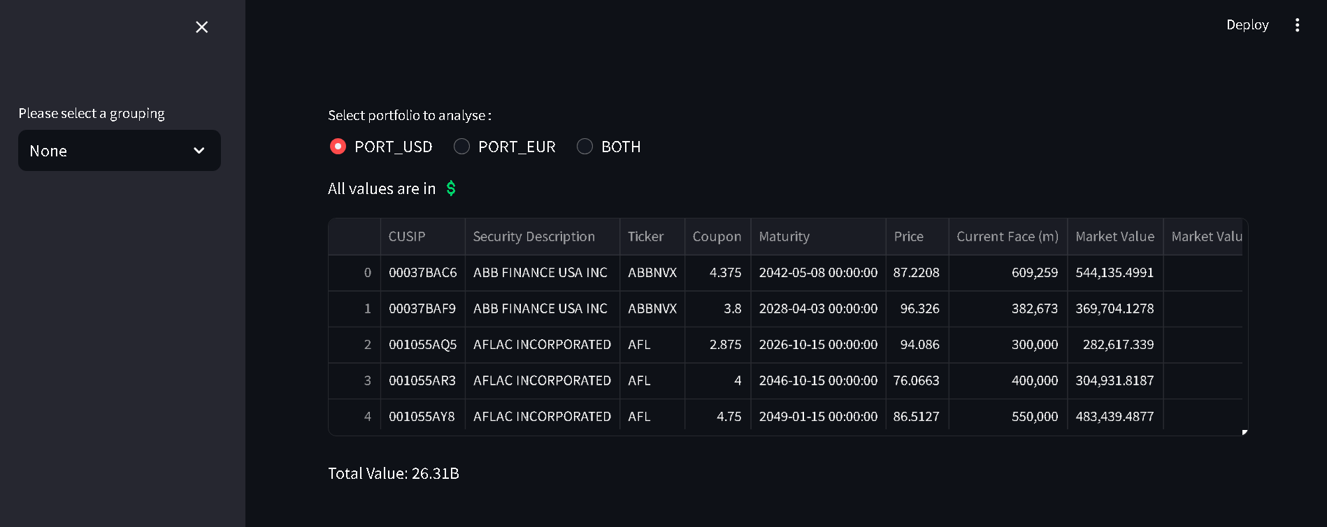

Slide 22
Key features
Easily accessible at streamlit community cloud
Minimalistic and Easy to read interface
Group data and visualize it by selecting the option from the sidebar
Chose the portfolio or visualize the combined portfolio
Future scope to add more charts and calculations

Slide 23

Github repository
https://github.com/Kenpachi99/Portfolio_analysis/tree/main

